Slide 1
Clinical and Health Equity
Updates for Screening
Catherine Kouchakji PhD, MPH
Wyoming Cancer Coalition Meeting
Cheyenne, Wyoming
June 26,2023

Slide 2
Disclosure
Employee of Exact Sciences in the Medical Affairs Division
December 2021

Slide 3
Cancer is the 2nd Leading Cause of Death in the US
~1.9 million
new cancer cases predicted in 2023*
In the US, an estimated
40 out of 100 men and 39 out of 100 women may develop cancer during their lifetime
>600,000
cancer deaths annually*
Approximately 610,000 Americans are projected to die from cancer in 2023
Health disparities
persist in cancer†
Underserved populations experience higher rates
of cancer and deaths due to delayed detection and suboptimal access to treatment
*Estimated new cases are based on 2005-2019 incidence data reported by the North American Association of Central Cancer Registries (NAACCR). Estimated deaths are based on 2006-2020 US mortality data, National Center for Health Statistics, Centers for Disease Control and Prevention.
†Cancer disparities are differences in cancer occurrence and outcomes according to sociodemographic factors, such as race, ethnicity, age, income, sexual orientation, or geographic location.
ACS. Cancer facts and figures 2023. Atlanta: American Cancer Society 2023.
Notes:
#1.
The fundamental driver for developing a better screening approach is that cancer is the second leading cause of death in the United States.
In 2023 alone approximately 1.9 million new cancer cases are projected in the United States, over the course of a lifetime, this means about one in two men and one in three women may develop cancer.
Even though cancer therapies continue to improve more than 600,000 people will lose their battle with cancer each year.
Adding to the challenge disparities persist in the acceptance and delivery of health care interventions across population groups with vulnerable or underserved populations continuing to experience higher cancer incidence and mortality rate.

Slide 4
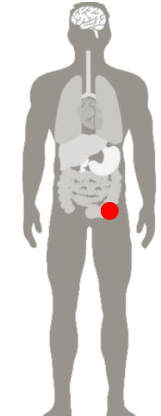
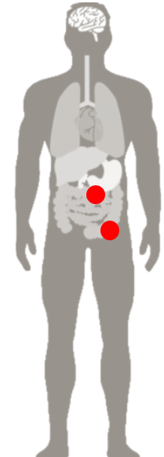
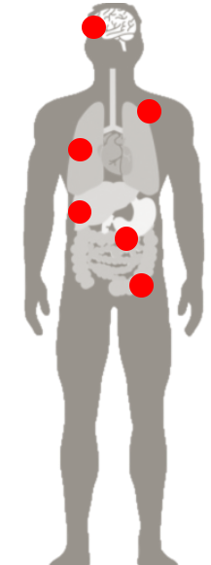
Earlier Detection is Associated with Longer Survival
Example: Colorectal Cancer*
LOCAL
Stage I, IIa, IIb
REGIONAL
Stage IIc, III
DISTANT METASTASIS
Stage IV
~91%
~73%
~14%
5-Year Survival
POST-DIAGNOSIS
5-Year Survival
POST-DIAGNOSIS
5-Year Survival
POST-DIAGNOSIS
*Five-year relative survival based on stage at diagnosis, United States, 2012 to 2018.
Siegel RL, et al. CA Cancer J Clin. 2023;73(1):17-48.
Notes:
Encouragingly clinical experience strongly supports the positive contribution that improved earlier detection strategies can have on reducing the cancer related mortality burden.
Overall average five-year survival rates for colorectal cancer exceed 90% for stages I, IIa, and IIb cancers with lower estimates of 73% for stage IIc and III, and only about 14% for stage for distant metastasis.

Slide 5
Current Cancer Screening Guidelines From USPSTF^{1,2}
Cancer | Population | Age at First Screening (years) | Screening Modality |  | Interval
Lung^{2,3} | High-risk | 50 if high-risk criteria are met | Low-dose CT |  | Every 1 year
Breast^{2,4} | Average-risk | 40 | Mammogram, Ultrasound, MRI |  | Every 1-2 years
Colorectal^{2,5} | Average-risk | 45 and older | Stool-based methods FIT mt-sDNA HS-gFOBT | Direct visualization CT colonography Colonoscopy Flexible sigmoidoscopy | 1-10 years, depending on test
Cervical^{2,6} | Average-risk | 21 | Pap test, HPV test |  | 3-5 years
Prostate^{2,7} | Individual basis | 55-69 | PSA |  | No recommendation
CT: computed tomography; FIT: fecal immunochemical test; HPV: human papillomavirus; HS-gFOBT: high-sensitivity guaiac-based fecal occult blood test; MRI: magnetic resonance imaging; mt-sDNA: multi-target stool DNA test; PSA: prostate-specific antigen; USPSTF: US Preventive Services Task Force.
1. Smith RA, et al. CA Cancer J Clin. 2019;69(3):184-210. 2. ACS. ACS guidelines for the early detection of cancer. Accessed August 15, 2022. https://www.cancer.org/healthy/find-cancer-early/american-cancer-society-guidelines-for-the-early-detection-of-cancer.html 3. Krist AH, et al. JAMA. 2021;325(10):962-970. 4. Siu AL, et al. Ann Intern Med. 2016;164(4):279-296. 5. Davidson KW, et al. JAMA. 2021;325(19):1965-1977. 6. Curry SJ, et al. JAMA. 2018;320(7):674-686. 7. Grossman DC, et al. JAMA. 2018;319(18):1901-1913.
Notes:
Present slide as is.
FAQ #1
What are the recommended screening tests for individual cancers?
The following figure details recommended screening tests and intervals for lung, breast, colorectal, cervical and prostate cancers.
References
1. ACS. ACS guidelines for the early detection of cancer. Accessed December 20, 2022. https://www.cancer.org/healthy/find-cancer-early/american-cancer-society-guidelines-for-the-early-detection-of-cancer.html
2. Krist, AH, et al. Screening for lung cancer: US Preventive Services Task Force recommendation statement. JAMA. 2021;325(10):962-970.
3. Siu AL and US Preventive Services Task Force. Screening for breast cancer: US Preventive Services Task Force recommendation statement. Ann Int Med. 2016;164(4):279-296.
4. Davidson KW, et al. Screening for colorectal cancer: US Preventive Services Task Force recommendation statement. JAMA. 2021;325(19):1965-1977.
5. Curry SJ, et al. Screening for cervical cancer: US Preventive Services Task Force recommendation statement. JAMA. 2018;320(7):674-686.
6. Grossman DC, et al. Screening for prostate cancer: US Preventive Services Task Force recommendation statement. JAMA. 2018;319(18): 1901-1913.

Slide 6










People Experience Multiple Barriers to Screening
Pain or discomfort in procedure^{1,2}
Lack of provider recommendation¹⁻³
Poor knowledge of risks or value of screening^{1,2}
Low priority and delay of scheduling³
Low literacy or language barriers^{1,2}
Lack of Transportation^{2,3}
Costs due to lack of income or insurance^{2,3}
Discrimination based on age, disability, race and income⁴
Fear or worry of results^{1,3}
1. Gesink D, et al. Cancer Epidemiol. 2016;45:126-134. 2. Alexandraki I, Mooradian AD. J Natl Med Assoc. 2010;102(3):206-218. 3. Muthukrishnan M, et al. Prev Med Rep. 2019;15:100896. 4. ACS website. Cancer disparities ACS research highlights. Accessed October 31, 2022. https://www.cancer.org/research/acs-research-highlights/cancer-health-disparities-research.html

Slide 7

CRC Overview
Epidemiology
Risk Factors, Signs, Symptoms
Prevention through Screening
COLORECTAL CANCER (CRC)
A PREVENTABLE DISEASE
CRC is often considered “the most preventable yet least prevented cancer” ¹
In a retrospective study of patients in the Kaiser Permanente Northern and Southern California systems, 76% of patients who died of CRC between 2006 and 2012, were not up-to-date with screening ²
1. Itzkowitz SH. J Natl Cancer Inst. 2009;101(18):1225-1227. doi:10.1093/jnci/djp273.
2. Doubeni KA, et al. Gastroenterol. 2019;156:63-74.
Notes:
________________________
MLR
Exact owns the rights to this image. It was acquired through our work with the Screening Has Meaning Campaign with Casanova.
Data from M-US-CG-03218

Slide 8
CRC Overview
Epidemiology
Risk Factors, Signs, Symptoms
Prevention through Screening
Incidence
Mortality
Age-Related Trends
Lowering the colorectal cancer screening age to 45 years is likely to impact colorectal cancer incidence and mortality in people aged 50- 54 years¹
52%
of people aged 50-54 years are not up-to-date on colorectal cancer screening¹
The incidence of colorectal cancer is increasing in people aged >54 years versus those aged 50-54 years²
1. Siegel RL, et al. CA Cancer J Clin. 2020;70(3):145-164. 2. Wolf, AMD, et al. CA Cancer J Clin. 2018;68:25-281.
Notes:
Read slide as indicated

Slide 9
CRC Overview
Epidemiology
Risk Factors, Signs, Symptoms
Prevention through Screening
Benefits of Screening
CRC Screening Adherence
CRC Screening Guidelines
Shared Decision
Making
Case Studies
What is the goal of colorectal cancer screening?¹
Five-year Survival Rates
(United States, 2019)
91%- Stage I/II^{1,2*}
15%- Stage IV^{1,2†}
Detect disease in asymptomatic individuals
Detect and remove precancerous growths
Detect disease at an earlier stage when treatment is more successful
Reduce colorectal cancer incidence and mortality
Increase survival
Notes:
Present from Slide
________________________
MLR
From US.CG.3737-4; pulled in stat noted on page 8

Slide 10
CRC Overview
Epidemiology
Risk Factors, Signs, Symptoms
Prevention through Screening
Benefits of Screening
CRC Screening Adherence
CRC Screening Guidelines
Shared Decision
Making
Case Studies
Colorectal cancer is “the most preventable yet least prevented form of cancer”¹
Percentage of Cases by Stage²
Yet >50% of colorectal cancer cases are diagnosed at regional and distant stages
*Based on people with CRC in stage I, stage IIa, or stage IIb between 2011 and 2017.
1. Itzkowitz SH. J Natl Cancer Inst. 2009;101(18):1225-1227. 2. NCI. SEER cancer stat facts: colorectal cancer. 2021. Accessed September 20, 2021. https://seer.cancer.gov/statfacts/html/colorect.html
Notes:
Early detection improves survival
Most cases are diagnosed in the localized or regional stage.
When diagnosed in stages I or II, 9 out of 10 patients survive 5 years whereas those who are diagnosed in stage IV, 1 out of 10 survive 5 years.
Localized: There is no sign that the cancer has spread outside of the colon or rectum. This includes AJCC stage I, IIa, and IIb cancers. Regional: The cancer has spread outside the colon or rectum to nearby structures or lymph nodes. This includes stage IIc and stage III cancers in the AJCC system. Distant: The cancer has spread to distant parts of the body such as the liver, lungs, or distant lymph nodes. This includes stage IV cancers.
ACS. Survival Rates for Colorectal Cancer, by Stage. https://www.cancer.org/cancer/colon-rectal-cancer/detection-diagnosis-staging/survival-rates.html. Accessed March 13, 2020.
________________________
MLR
Graph and “Colorectal cancer is “the most preventable yet least prevented form of cancer”¹ pulled from US.CG.3737-4

Slide 11
CRC is Preventable and Treatable if Detected in Earlier Stages¹
70% of CRCs develop from adenomas²
Up to 30% of CRCs develop from sessile serrated polyps²
Polyp
In Situ
Local
Regional
Distant
>10 Years²
5-yr survival^{1,3†}
Stage I or II*
Stage IV
91%
15%
*Based on people diagnosed with CRC in stage I, stage IIa, or stage IIb between 2011 and 2017.
† Per American Joint Committee on Cancer (AJCC) staging system: Localized = Stage I, IIa, IIb. Regional = stage IIc and III. Distant = stage IV.
1. Siegel RL, et al. CA Cancer J Clin. 2022;72:7-33. 2. Rex DK, et al. Am J Gastroenterol. 2017:112(7):1016-1030. 3. ACS. Survival rates for colorectal cancer, by stage. Accessed February 8, 2022. https://www.cancer.org/cancer/colon-rectal-cancer/detection-diagnosis-staging/survival-rates.html
Notes:
Key Points:
CRC is one of the most preventable and treatable forms of cancer, with survival rates that are significantly affected by the stage at diagnosis [Itzkowitz 2009 p1225/col1/para1/line1-2]
Approximately 70% of CRC develops from colorectal adenomas. And Up to 30% of CRCs develop from sessile serrated polyps. [Rex 2017 p4/col1/para1/line1-2] & [Rex 2017 p4/col2/para2/line1-3]
The evolution of a colorectal adenoma to early CRC typically takes more than 10 years, which provides an important window of opportunity to detect adenomas and early-stage CRC [Rex 2017 p4/col1/para1/line2-5]
Based on data from SEER 18 2011–2017, All Races, Both Sexes by SEER Summary Stage 2000:
overall 5-year relative survival is 65%
By stage 5-year: localized 91%, regional 72%, distant 15% [Siegel pg16/Fig4/colorectum]

Slide 12
How is “Average Risk” for CRC Defined?
Asymptomatic patients are generally considered to be at average risk for CRC if they do NOT have the following:^{1-5†}
A Personal History* of
A Family History of
  CRC, adenomatous polyps, or IBD (including Crohn’s disease and ulcerative colitis)
  A confirmed or suspected hereditary CRC syndrome (such as familial adenomatous polyposis or Lynch syndrome)
  First-degree relatives (parents, siblings, children) who had CRC, adenoma or sessile serrated polyp
  Familial adenomatous polyposis
  Hereditary nonpolyposis CRC syndrome
The Following Factors May Be Considered When Estimating CRC Risk for Average-risk Individuals, But These Alone Do Not Elevate People Beyond the Average-risk Category^{5†}
Cigarette smoking
Lack of physical activity
Moderate to high consumption of alcohol and/or long-term consumption of red and processed meat
Low consumption of fiber, calcium, fruits, and vegetables
Diabetes
Excess body weight
*ACS guideline excludes patients with radiation to the abdomen/pelvic area to treat prior cancer from the average-risk category.
†All recommendations are category 2A unless otherwise indicated. The National Comprehensive Cancer Network (NCCN®) makes no representations or warranties of any kind regarding their content, use or application and disclaims any responsibility for their application or use in any way.
CRC: colorectal cancer
1. American Cancer Society. Colorectal Cancer Facts & Figures 2020-2022. Atlanta: American Cancer Society; 2020. 2. Davidson KW, et al. JAMA. 2021;325(19):1965-1977. 3. Wolf AMD, et al. CA Cancer J Clin. 2018;68(4):250-281. 4. Rex DK, et al. Am J Gastroenterol. 2017;112(7):1016-1030. 5. Referenced with permission from the NCCN Clinical Practice Guidelines in Oncology (NCCN Guidelines®) for Colorectal Cancer Screening V.2.2021. © National Comprehensive Cancer Network, Inc. 2022. All rights reserved. Accessed February 8, 2022. To view the most recent and complete version of the guideline, go online to NCCN.org.
Notes:
Key Points:
The concept of “average risk” vs “high risk” is key to making decisions about CRC screening; while there are common features, the definition of “average risk” is not uniformly consistent in the scientific literature
A patient is considered to be in the average-risk category if he or she is not in the high-risk category or has no known risk factors other than age
High risk is generally defined as having any of the following:
A personal history of
Colorectal cancer, adenomatous polyps, or inflammatory bowel syndrome
A confirmed or suspected hereditary CRC syndrome
ACS only has an additional category: ACS excludes patients with radiation to the abdomen/ pelvic area to treat prior cancer from the average-risk category (reflected in the footnote section)
And/or a family history of
First-degree relative (parents, siblings, children) who has had CRC, adenoma or sessile serrated polyp
Familial adenomatous polyposis
Hereditary nonpolyposis colorectal cancer
Certain factors associated with Western lifestyles are known to increase the risk of developing CRC. While assessment of these factors provides an important opportunity for lifestyle modification advice, their presence is not considered sufficient to elevate individuals beyond the average-risk category, and there is no evidence to support their use in stratifying subgroups of the population within the average-risk category.
Additional information on CRC risk factors:
CRC Risk factors according to NCI (the most complete list, no direct evidence available, only associations). NCCN 2021 guideline update also includes low levels of Vitamin D association with increased risk for CRC.
https://www.cancer.gov/types/colorectal/patient/colorectal-prevention-pdq
The following risk factors increase the risk of colorectal cancer:
Age
Family history of colorectal cancer
Personal history
Inherited risk
Alcohol
Cigarette smoking
Race
Obesity
The following protective factors decrease the risk of colorectal cancer:
Physical activity
Aspirin [The USPSTF has made a recommendation statement on aspirin use to prevent cardiovascular disease and colorectal cancer. As stated in Figure 1 of JAMA article]
Combination hormone replacement therapy
Polyp removal
It is not clear if the following affect the risk of colorectal cancer:
Nonsteroidal anti-inflammatory drugs (NSAIDs) other than aspirin
Calcium
Diet
The following factors do not affect the risk of colorectal cancer:
Hormone replacement therapy with estrogen only
Statins
Reference Annotations:
Modifieable risk factors [ACS CRC Facts&Fig 2020-2022 p13/col1para1/line1-10]
Nonmodifiable risk factors [ACS CRC Facts&Fig 2020-2022 p13/col1para2-3]

Slide 13
Colorectal Cancer (CRC) is the 4th Most Common Cancer and the 2nd Leading Cause of Cancer Deaths
Estimated*† new cases in 2022
Estimated*† deaths in 2022
Female Breast
Lung and Bronchus
Prostate
Colon and Rectum
52,580
Lung and Bronchus
Pancreas
Colon and Rectum
149,500
Female Breast
151,030
Melanoma of Skin
Prostate
NOTE: These are model-based estimates that should be interpreted with caution and not compared with those for previous years.
Source: Estimated new cases are based on 2004-2018 incidence data reported by the North American Association of Central Cancer Registries (NAACCR). Estimated deaths are based on 2005-2019 US mortality data, National Center for Health Statistics, Centers for Disease Control and Prevention.
*Estimates are rounded to the nearest 10; cases exclude basal cell and squamous cell skin cancers and in situ carcinoma except urinary bladder.
†The 2022 projections are based on currently available incidence and mortality and do not reflet the impact of COVID-19 on cancer cases and death.
CRC: colorectal cancer.
Siegel RL, et al. CA Cancer J Clin. 2022;72:7-33.
Notes:
Key Points:
An estimated 150,000 new cases of CRC will be diagnosed in the United States in 2022 [Siegel 2022 p10/Table1]
CRC remains the second leading cause of cancer mortality in the United States and the third for men or women behind prostate cancer, breast, and lung cancer. The American Cancer Society estimates that ~53,000 patients will die from CRC in 2022
The overall lifetime risk of developing CRC from birth to death for men is 4.2% (1 in 24) and for women is 4.0% (1 in 25) [Siegel 2022 p12/Table 3]
These estimates are based on reported cancer incidence and mortality through 2016 and 2018, respectively, and do not account for the unknown impact of COVID-19 on cancer diagnoses and deaths.
------------------------------------
Footer on the slide:
Source: Estimated new cases are based on 2004-2018 incidence data reported by the North American Association of Central Cancer Registries (NAACCR).
Estimated deaths are based on 2005-2019 US mortality data, National Center for Health Statistics, Centers for Disease Control and Prevention.

Slide 14
CRC Overview
Epidemiology
Risk Factors, Signs, Symptoms
Prevention through Screening
Incidence
Mortality
Age-Related Trends
Siegel RL, et al. CA Cancer J Clin. 2022;72(1):7-33. doi:10.3322/caac.21708.
Notes:
Read slide as is (this language is from US.CG.3737-4
Colorectal cancer (CRC) is the third most common cause of cancer death in both men and women in the United States, and ranks second when men and women are combined.1
One in 17 Americans will suffer from CRC during their lifetime; the lifetime risk is 30% higher for men than for women. (Siegel RL, et al. CA Cancer J Clin. 2022;72(1):7-33. doi:10.3322/caac.21708.)
________________________
MLR
Stats from M-US-CG-03218 and US.CG.3737-4
Graph is replicated from Table 10 from Siegel et al article

Slide 15
CRC Overview
Epidemiology
Risk Factors, Signs, Symptoms
Prevention through Screening
Incidence
Mortality
Age-Related Trends
Siegel RL, et al. CA Cancer J Clin. 2022;72(1):7-33. doi:10.3322/caac.21708.
Notes:
________________________
MLR
Stats from M-US-CG-03218 and US.CG.3737-4
Graph is replicated from Table 10 from Siegel et al article

Slide 16
National Organizations Recommend Routine CRC Screening for Patients at Average Risk for CRC¹⁻⁵
US Preventive
Services Task Force
(USPSTF) 2021¹
American
Cancer Society
(ACS) 2018²
NCCN Clinical Practice Guidelines in Oncology
(NCCN Guidelines®)
2021^{3*}
American College of Gastroenterology
(ACG) 2021⁴
Multi-Society
Task Force
(MSTF) 2021⁵**
Begin Screening
at Age 45
Grade B†
recommendation
Qualified‡
Recommendation
Category 2A§
Conditional recommendation (suggested); very low-quality evidence
Weak recommendation; low-quality evidence
Begin Screening
at Age 50
Grade A†
recommendation
Strong
Recommendation
Strong recommendation; moderate-quality evidence
Strong recommendation, high-quality evidence
75; after 75, it is an
individualized decision
Grade C† recommendation
75 years
(strong recommendation; moderate-quality evidence)
Continue Screening
Until Age
75
Decision for ages 76-85 years should be individualized
75 or when life expectancy is <10 years
†The USPSTF concludes with moderate certainty that screening for CRC in adults aged 45 to 49 years has moderate net benefit (Grade B). The USPSTF concludes with high certainty that screening adults aged 50 to 75 years has substantial net benefit (Grade A). The USPSTF concludes with moderate certainty that there is a small net benefit of screening for colorectal cancer in adults aged 76 to 85 y who have been previously screened (Grade C).
‡The “qualified” designation indicates that there is clear evidence of benefit (or harm) but some uncertainty on the balance of benefits/harms or patient values/preferences, which can influence individual decisions.
*All recommendations are category 2A unless otherwise indicated. The National Comprehensive Cancer Network (NCCN®) makes no representations or warranties of any kind regarding their content, use or application and disclaims any responsibility for their application or use in any way.
§Recommend a discussion of potential harms/risks and benefits and consideration of all recommended CRC screening options.
**The United States Multi-Society Task Force on Colorectal Cancer includes the American College of Gastroenterology (ACG), the American Gastroenterological Association (AGA), and the American Society for Gastrointestinal Endoscopy (ASGE).
16
US.CG.4030-1
CRC: colorectal cancer.
1. Davidson KW, et al. JAMA. 2021;325(19):1965-1977. 2. Wolf AMD, et al. CA Cancer J Clin. 2018;68(4):250-281. 3. Referenced with permission from the NCCN Clinical Practice Guidelines in Oncology (NCCN Guidelines®) for Colorectal Cancer Screening V.2.2021. © National Comprehensive Cancer Network, Inc. 2022. All rights reserved. Accessed February 8, 2022. To view the most recent and complete version of the guideline, go online to NCCN.org.
4. Shaukat A, et al. Am J Gastroenterol. 2021; 116:458-479. 5. Patel SG, et al. Gastroenterol. 2022;162(1):285-299.
Notes:
Key Points:
Despite some variations in their respective guidelines, the USPSTF, NCCN, ACG, and MSTF recommend routine CRC screening for patients with average risk between the ages of 45 and 75 years¹⁻⁵
In May 2018, the American Cancer Society revised its CRC screening guidelines to include patients 45 years or older with an average risk of CRC who should undergo regular screening with a choice of either a high-sensitivity stool-based test or a structural (visual) exam, depending on patient preference and test availability¹
The ACS based their recommendation on colorectal cancer (CRC) incidence and mortality rates, results from microsimulation modeling that demonstrate a favorable benefit-to-burden balance of screening beginning at age 45, and the expectation that screening will perform similarly in adults ages 45-49 as it does in adults ages 50 and older [Physicians Brochure]
The strong recommendation for average risk patients ages 50-75 conveys the consensus that the benefits of adherence to that intervention outweigh the undesirable effects that may result from screening, and a qualified recommendation for ages 45–49 indicates there is clear evidence of benefit of screening but less certainty about the balance of benefits and harms or about patients’ values and preferences, which could lead to different decisions about screening.¹
In 2021, The USPSTF recommendations included individuals between the ages of 45 and 49 for screening, while prior recommendations started screening at age 50. The level of evidence for screening from 45-50 years of age is moderate² {Davidson, p1968 Figure 1}
Modeling performed by the Cancer Intervention and Surveillance Modeling Network (CISNET) suggests that starting colorectal cancer screening at age 45 years may moderately increase life-years gained and decrease colorectal cancer cases and deaths compared with beginning screening at age 50 years² {Davidson, USPSTF 2021 p1969 c1 pa2 last 5 lines}
Most recently, MSTF published updated recommendations as to when to start and stop CRC screening stating “We suggest that clinicians offer CRC screening to all
average-risk individuals age 45-49 (weak recommendation; low-quality evidence).” (Patel 2021 pg10/Table4)
Screening in patients older than 75 years is an individualized decision based on factors including patient health, comorbidities, life expectancy, CRC screening history, and patient preferences¹⁻⁴
These national guidelines also agree that among patients at average risk who are older than 75, those with no screening history are most likely to benefit from CRC screening¹⁻⁵
References:
Wolf AMD, Fontham ETH, Church TR, et al. Colorectal cancer screening for average-risk adults: 2018 guideline update from the American Cancer Society. CA Cancer J Clin. 2018;68(4):250-281.
Davidson KW, et al. Screening for colorectal cancer: US Preventive Services Task Force recommendation statement. JAMA. 2021;325(19):1965-1977.
3. Referenced with permission from the NCCN Clinical Practice Guidelines in Oncology (NCCN Guidelines®) for Colorectal Cancer Screening V.2.2021. © National Comprehensive Cancer Network, Inc. 2022. All rights reserved. Accessed _________, 2022. To view the most recent and complete version of the guideline, go online to NCCN.org.
4. Patel SW, May FP, Anderson JC, et al. Updates on age to start and stop colorectal cancer screening: recommendations from the US Multi-Society Task Force on colorectal cancer. Gastroenterol. 2022;162(1):285-299.

Slide 17
CRC Screening Status: Progress and National Goal
CRC Screening Rates Are Lower than for Breast and Cervical Cancers and Continue to Fall Short of the NCCRT National Goal (80%)^{1-3,*}
NCCRT CRC screening goal³*
80% in Every Community
National CRC
Screening Rate:
67%^{1†}
1 in 3 adults
ages 50–75 are not screened as recommended¹
*The NCCRT has established the goal of 80% of adults ages ≥50 being regularly screened for CRC.³
†Source: National Health Interview Survey, 2018.
CRC: colorectal cancer, NCCRT: National Colorectal Cancer Roundtable
1. ACS. Colorectal Cancer Facts & Figures 2020-2022. Atlanta: American Cancer Society; 2020. 2. ACS. Cancer prevention & early detection facts & figures tables and figures 2020. Atlanta: American Cancer Society; 2020. 3. NCCRT website. 80% in Every Community, talking points. Updated February 2019. Accessed February 8, 2022. https://nccrt.org/80-in-every-community/
Notes:
Key Points:
According to the National Health Interview Survey conducted in 2018, screening rates for CRC continued to lag behind those for cervical cancer [84%; Pap test in the past 3 years among women 21-65 years OR Pap test and HPV test within the past 5 years among women 30-65 years] and breast cancer [63%; Mammogram within the past year (ages 45-54 years) or past two years (ages ≥55 years].¹
National screening rates for CRC also continue to fall short of the National Colorectal Cancer Roundtable’s (NCCRT’s) established national goal of 80% compliance with CRC screening in patients ages ≥45 in every community²
As of 2018, 67% of the 50-75 age population was up to date on CRC screening which means 1 out of 3 (33%) were not up to date.³
References
ACS. Cancer prevention & early detection facts & figures tables and figures 2020. Atlanta: American Cancer Society; 2020.
NCCRT. Achieving 80% colorectal cancer screening rates in every community. Accessed November 1, 2020. https://nccrt.org/80-in-every-community/. Accessed November 1, 2020.
ACS. Colorectal Cancer Facts & Figures Tables and Figures 2020. Atlanta: American Cancer Society; 2020.

Slide 18
CRC Screening Rates Have Not Reached National Goal of 80% in Any State
Adults Aged 50–75 Years Who Report Being Up-to-Date† With CRC Screening, by State (2018)
NH
75
VT
72
71
64
67
73
75
MA
55.0–59.9%
70.0–74.9%
72
77
RI
66
69
75
70
76
58
74
CT
60.0–64.9%
≥75.0%
71
72
75
60
68
NJ
67
68
67
67
70
69
67
65.0–69.9%
72
67
69
70
DE
69
72
69
71
MD
66
64
62
66
70
73
DC
60
62
70
68
74
60
69
69
HI
75
PR
55
†Up-to-date: fecal occult blood test (FOBT) within 1 year, or sigmoidoscopy within 5 years, or colonoscopy within 10 years.
CRC: colorectal cancer
American Cancer Society. Colorectal Cancer Facts & Figures 2020-2022. Atlanta: American Cancer Society; 2020.
Notes:
Key Points:
The percentage of adults aged 50 to 75 years who were up-to-date with colorectal cancer (CRC) screening increased by 1.4% from 2016 to 2018.
4.2 million more adults aged 50 to 75 years were screened for CRC
21.7 million adults aged 50 to 75 years who have never been screened for CRC
81% of adults who have never been screened are people aged 50 to 64 years
Optional information: States with +/-3% difference in 2018 vs 2016:
States that had 3+% increases: 1) MI (+4.4) 2) LA (+4.9) 3) OR (+3.2) 4) ID (+3.9) 5) AZ (+3.4) 6) NM (+5.5) 7) SD (+3.4) 8) OK (+3.2) 9) MO (+3.8) 10) IL (+3.2) 11) MS (+4.1) 12) IN (+3.4) 13) TN (+3.4) 14) GA (+4.8) 15) FL (+3.2) 16) MD (+3.5) 27) DC (+4.0)
States that -3% decreases: 1) AK (-3.4) 2) WY (-2.9)
https://www.cdc.gov/cancer/colorectal/statistics/pdf/colorectal-cancer-screening-tests-h.pdf

Slide 19
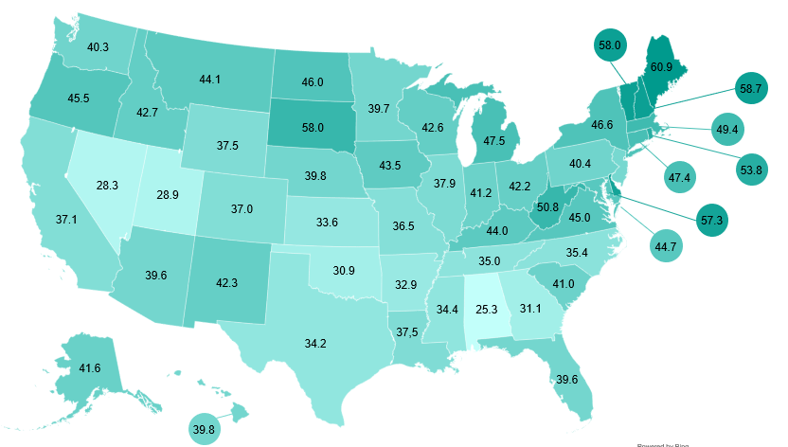
CRC Overview
Epidemiology
Risk Factors, Signs, Symptoms
Prevention through Screening
Benefits of Screening
CRC Screening Adherence
CRC Screening Guidelines
Shared Decision
Making
Case Studies
CRC SCREENING* RATES BY STATE (%), ADULTS AGED 50-74 YEARS, 2020 at FQHCs
The national colorectal cancer screening rate among patients served by FQHCs is 40%.
* “Appropriate screening” for colorectal cancer
HRSA. 2020 Health Center Data. Accessed February 22, 2022. https://data.hrsa.gov/tools/data-reporting/program-data/national/table?tableName=Full&year=2020 ​
Notes:
________________________
MLR
M-US-CG-03218

Slide 20
Barriers to CRC Screening: Clinician-perceived
93 PCPs from 13 Accountable Care Organization clinics, primarily in rural communities
Survey on significance of patient, provider, and system level barriers
Patient Level
Provider Level
System Level
Barrier to Screening %
Fear of discomfort
or pain
Finances
Other health issues
Lack of awareness
Health
literacy
Fatalistic attitude toward cancer
Lack of time to discuss screening
Lack of
provider
recommend-ation
Questions on efficacy of screening
Lack of reminder system
Lack of support
staff
Shortage of screening facilities
Limitations: Generalizability of the study findings (data from rural clinics, all possible barriers may not have been identified since study focused on clinician-perceived benefits, they may be different than what patients perceive, and providers race and ethnicity may influence what they perceive as barriers).
CRC: colorectal cancer; PCP: primary care provider
Wang H, et al. JOJ Public Health. 2017;1(2):555-557.
Notes:
Speaker Notes:
This survey aimed to evaluate clinicians’ perceptions about barriers to CRC screening. The survey was conducted in 13 primary care clinics in Nebraska, with responses collected from a total of 93 primary-care physicians.
Clinicians perceived that most barriers to CRC screening were at the patient level.
Patients’ fear of discomfort or pain was cited by 70% and financial barriers by 62% of physicians.
Fewer respondents cited system barriers, including lack of reminder system (36%) and lack of support staff (25%), or provider-level barriers, such as lack of time to discuss screening (21%), lack of recommendations (6.6%), or questions about screening efficacy (5.6%)
The results highlight the need to address patient, provider, and system-level barriers to CRC screening

Slide 21


Barriers to Follow Up Colonoscopy
Survey in patients with positive FIT or mt-sDNA results
Patient Level
Provider Level
System Level
Barrier (%)
Refusal
before
ordered
Refusal
after
ordered
No show/
cancellation
Did not complete bowel prep
Other
reason
Attributed
to false
positive
Failure
to Inform
patient
Attributed
to other
reasons
Recent
colonoscopy
done
Other
health
issue
to prioritize
Unknown
GI
clinic referral
Colonoscopy not
scheduled
Positive FIT results n=308, positive Cologuard results n=323
FIT: fecal immunochemical test; GI: gastrointestinal
Cooper GS, et al. J Am Board Fam Med. 2021;34(1):61-69.
Notes:
There are also barriers to follow up colonoscopy.
Purpose:
To evaluate the frequency of follow-up colonoscopy after a FIT or mt-sDNA positive test and determine reasons for lack of follow-up colonoscopy using electronic medical records from a large vertically integrated health care system.
Methodology
Time-to-colonoscopy was determined by screening test date to the colonoscopy date. For those who did not have a colonoscopy, the date was censored to last follow-up (December 31, 2019)
Time to colonoscopy was analyzed using univariate Cox regression analysis to determine hazard ratio (HR) and corresponding 95% CI
Inclusion criteria
Patients aged 40 years and older with a positive FIT or mt-sDNA test between January 2016 and June 2018
Exclusion criteria
Patients with a missing date of stool test or colonoscopy
Results:
Of the 308 patients with FIT+ results, 144 (46.7%) patients underwent a colonoscopy within 6 months (48.6% had precancerous or malignant lesions)
Of the 323 patients with mt-sDNA+ results, 231 (71.5%) underwent a colonoscopy within 6 months (77.1% had precancerous or malignant lesions) [Cooper 2021 p63/col2/para1/line17-19 & para2/line20-22]
The median time-to-colonoscopy was 2.2 months for mt-sDNA patients and >6 months for FIT+ patients (median time-to-colonoscopy for FIT+ patients was N/A as 50% rate was not achieved; HR=1.83, 95% CI, 1.48-2.25; p-value <0.0001)
Providers did not order a colonoscopy for 135 of the FIT+ patients (43%) and 47 of the mt-sDNA+ patients (15%)
Top reasons for lack of follow-up after positive test: [Cooper 2021 p/65/Table3]
FIT+:
29.3%: provider referred to GI clinic appointment (instead of ordering directly) that patient didn’t keep
23.8%: positive FIT was attributed to other causes than possible colorectal pathology
14.6%: patients had a colonoscopy within the past year and deemed unnecessary by the provider
Colonoscopy was ordered but not completed by 30 (18%)
Most common reasons were that patients did not show or cancelled their appointment. Other reasons included patients refusing or not scheduling the procedure, and having other health issues to prioritize
mt-sDNA+:
25% of patients expressed unwillingness to undergo colonoscopy
Colonoscopy was ordered and not completed in 45 patients (49%)
The most common reasons for the lack of colonoscopy completion were the patient refusing or not scheduling the colonoscopy and the patient cancelling or not showing up to their colonoscopy appointment
12%: provider referred to GI clinic appointment that patient didn’t keep
7.6%: provider failed to inform the patient of their positive mt-sDNA results
Cooper GS, Grimes A, Werner J, Cao S, Fu P, Stange KC. Barriers to follow-up colonoscopy after positive FIT or multitarget stool DNA testing. J Am Board Fam Med. 2021;34(1):61-69. doi:10.3122/jabfm.2021.01.200345

Slide 22
CRC Screening Adherence: Choice of Screening Tests
Randomized clinical trial in 997 adults aged 50–79 at average risk of CRC
Screening recommendations: FOBT, Colonoscopy, or Choice of FOBT or Colonoscopy
P=.64
P<.001
P<.001
69%
31% increase
(n=344)
(n=332)
(n=321)
CRC: colorectal cancer, FOBT: fecal occult blood test
Inadomi JM et al. Arch Intern Med. 2012;172(7):575-582.
Notes:
Key Points
This study, conducted in the San Francisco Community Health Network, enrolled 997 patients aged 50-79 years at average risk of CRC. Primary care physicians in each clinic were assigned to provide their patients an initial recommendation for CRC screening by FOBT, colonoscopy, or a choice of FOBT or colonoscopy. The primary outcome of the study was completion of CRC screening within 12 months.
Within 12 months of enrollment, 58% of participants overall completed the screening strategy to which they were assigned or that they chose.
A significantly lower proportion of participants completed colonoscopy (38%) compared with the proportion completing FOBT (67%) (P<0.001) or participants who were allowed to choose their screening strategy (69%) (P<0.001)
Offering a choice of screening method may be linked to greater patient adherence
The investigators also found that cultural influences may play a role in CRC screening adherence. Specifically, African-American, Asian, and Latino patients preferred non-invasive fecal testing (i.e., gFOBT), whereas Caucasian patients preferred colonoscopy.
[Inadomi 2012 p1/para3 Results/line1-4]

Slide 23
Screening Adherence with Cologuard
Retrospective database studies of Cologuard cross-sectional adherence within 365 days of order
71.1%
Medicare Beneficiaries
Ages 60 - 85 years (N=368,494)
Cologuard orders placed September 2016 to August 2017
Weiser E et al. J Med Screen. 2021;28(1):18-24
66.8%
Commercial insurance or Medicare
Ages 50 years and above (N=1,420,460)
Cologuard orders shipped January 2018 to December 2018
Miller‑Wilson L et al. Int J Colorectal Dis. 2021;30:2471-2480
Notes:
Key Points:
CG showed high screening adherence within 1 year of order date. As shown in these 2 large scale studies, the screening adherence is 67 – 71 %, which is higher than reported adherence of other stool-based tests.
Weiser et al 2021 included patients with Traditional Medicare and Medicare Advantage. [Weiser 2021 p18/abstract/results/line1]
Miller-Wilson et al 2021 included and analyzed patients with:
Commercial insurance (61.9% adherence, n=654,859),
Traditional Medicare (72.1% adherence, n=476,071), and
Medicare Advantage (69.1% adherence, n=289,530). [Miller-Wilson 2021 p1/abstract/results/line1, n-values in Table 1]

Slide 24
Colonoscopy Completion After Positive FIT or Cologuard Results
Retrospective cohort studies of patients with positive FIT or positive Cologuard results, and the adherence rate to follow-up colonoscopy
FIT 47%
Single academic health system
308 FIT positive and 323 Cologuard positive patients from January 2016 and June 2018
Colonoscopy completion rate within 6 months
Cologuard 72%
Cooper GS, et al. J Am Board Fam Med. 2021;34(1):61-69.
Mayo Clinic system across multiple states
1801 Cologuard positive patients included from October 2014 to December 2017
Colonoscopy completion by April 2018
Cologuard 87%
Eckmann J, et al. Am J Gastroenterol. 2020;115(4):608-615.
Notes:
Key Points:
Cologuard appears to lead to high rates of follow-up colonoscopy after positive results.
In the Cooper study, the completion rate of follow up colonoscopy within 6 months in patients with a positive CG results was 72%, and that in patients with a positive FIT result was 47%. [Cooper 2021 p61/abstract/results/line1-3]
In the Eckmann study, the completion rate of follow up colonoscopy in patients with a positive CG result was 87%. The study included all patients with mt-sDNA tests completed at any Mayo Clinic site between Oct 1, 2014 and Dec 31, 2017. The follow-up period was only bound by the end of the data collection date, April 2018. The median follow up was 44 days (IQR 28-72). [Eckmann 2020 p610/col1/para3/line4-6]

Slide 25
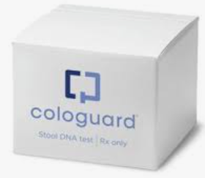
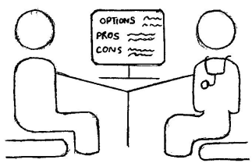




Unique Support System
Patient Navigation and Provider Support
Informed Decision Making
1. Provider orders the test:
FAX, Epic, EHR
2. Lab ships the
kit to the patient
24/7, 240+ languages
Support Patients and Providers
Welcome, reminders, follow up
6. Provider receives the Result
3. Patient collects &
ships the sample
5. Lab processes
the sample
and run tests
4. UPS® picks up,
ships, and delivers the sample
EHR: electronic health record.
Notes:
Cologuard has a unique built-in navigation system to support HCPs and patients.
The system functions 24/7/365 with live support in >240 languages.
All mt-sDNA test orders are supported by the system
Exact Sciences Lab ships the kit and instructions directly to the patient and contacts the patient for support collecting and returning the completed mt-sDNA kit. Patient Navigation support services:
Include a welcome call and mail, email and/or text reminders
Patient completes the test and ships the kit back to the Exact Sciences Laboratories for processing (via pre-paid UPS label)
Exact Sciences Laboratories processes and analyzes the patient’s mt-sDNA test and typically provides a result to the ordering provider within 2 weeks
Provider reviews the results and performs appropriate patient follow-up:
Positive result → Follow-up colonoscopy referral
Negative result → Continued screening & risk assessment at appropriate intervals (every 3 years†)

Slide 26
Summary: Colorectal Cancer Burden Reduction
CRC is the fourth most common cancer and the second leading cause of cancer deaths, but it is also preventable and treatable if detected in earlier stages^{1,2}
National guidelines recommend routine CRC screening for average risk persons 45 or older^{3-6*}
Fear, finances, and logistics are the leading barriers to CRC screening⁷
Informed decision making and test choice improve screening adherence⁸
*All recommendations are category 2A unless otherwise indicated. The National Comprehensive Cancer Network (NCCN®) makes no representations or warranties of any kind regarding their content, use or application and disclaims any responsibility for their application or use in any way.
CRC: colorectal cancer
1. Siegel RL, et al. CA Cancer J Clin. 2021;71(1):7-33. 2. Itzkowitz SH, et al. J Natl Cancer Inst. 2009;101(18):1225-1227. 3. Davidson KW, et al. JAMA. 2021;325(19):1965-1977. 4. Wolf AMD, et al. CA Cancer J Clin. 2018;68(4):250-281. 5. Referenced with permission from the NCCN Clinical Practice Guidelines in Oncology (NCCN Guidelines®) for Colorectal Cancer Screening V.2.2021. © National Comprehensive Cancer Network, Inc. 2022. All rights reserved. Accessed February 8, 2022. To view the most recent and complete version of the guideline, go online to NCCN.org. 6. Patel SG, et al. Gastroenterol. 2022;162(1):285-299. 7. Muthukrishnan M, et al. Prev Med Rep.2019;15:100896. 8. Inadomi JM et al. Arch Intern Med. 2012;172(7):575-582.
Notes:
Present from Slide

Slide 27
The Challenge: Routine Screening Exists for ~30% of Incident Cancers
~67%
of incident cancer diagnoses have no standard of care screening tests¹
~33%
standard of care screenings*
*Calculated using estimated new cases of cancers that have standard of care screening: breast, cervical, colorectal and lung (high-risk for each sex) against all sites.
Siegel RL, et al. CA Cancer J Clin. 2023;73(1):17-48.
Notes:
Despite the strong rationale for better early detection strategies most practice guidelines currently endorsed screening for only about 33% of all incident cancers.
Meaning that about 67% percent or approximately 7 and 10 cancers have no standard of care screening tests.
The unfortunate reality is that the majority of patients are diagnosed after the onset of clinical symptoms or signs which may require extensive evaluation to identify an underlying malignancy that oftentimes is then found at a later less treatable stage of disease.

Slide 28



A Potential Breakthrough in Finding Cancer Earlier: Multi-Cancer Early Detection (MCED)
MCED has the potential to transform cancer detection
Using a simple blood draw, it can detect multiple cancer types^{1,2}
Expanding access to screening for underserved populations
MCED + routine screening methods may greatly expand the range of detectable cancers³
High specificity by design to limit false positives
Ultimately, MCED may identify cancers at earlier stages, when they may be more treatable³
1. Cohen JD, et al. Science. 2018; 926-930. 2. Lennon AM, et al. Science. 2020;369(6499). 3. Ezell S. Seizing the transformative opportunity of multi-cancer early detection. Information and Innovation Foundation. April 19, 2021. Accessed August 19, 2022. https://itif.org/publications/2021/04/19/seizing-transformative-opportunity-of-multi-cancer-early-detection

Slide 29
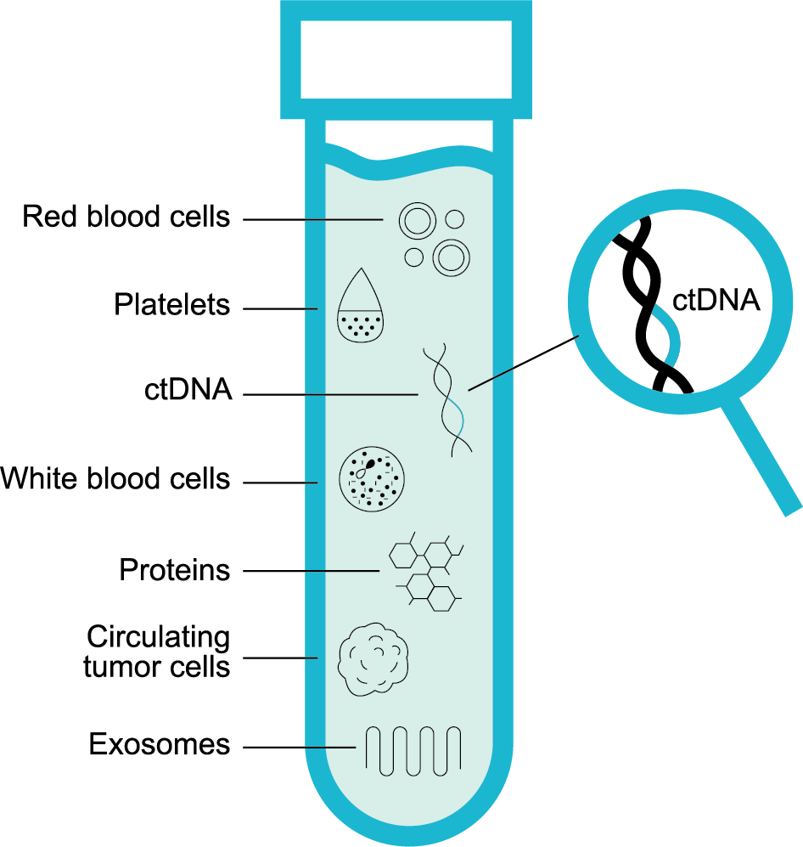


Multi-Cancer Early Detection Examines a Blood Sample for ctDNA and Other Soluble Biomarkers
When healthy and abnormal cells die, they release cell-free DNA (cfDNA) into the bloodstream¹
If a tumor is present, the cfDNA may contain circulating tumor DNA (ctDNA)¹
Multiple circulating biomarkers can contribute to MCED’s ability to detect the presence of cancer²
Aneuploidy
Mutations
Methylation
1. Klein EA, et al. Ann Oncol. 2021;32(9):1167-1177. 2. Cohen et al., Science. 2018:359(6378):926-930.
Disclaimer: This technology is under development and the features above describe current development goals. It has not been cleared or approved by the US Food and Drug Administration (FDA) or any other national regulatory authority.
Notes:
MLR: Graphic created for EXAS use.
FAQ #4
How can MCED technology detect cancer in the body?
Cancer cells can release different substances (biomarkers) into the blood stream in characteristic combinations.1 Cancer can be detected by measuring these substances and searching for unique biomarker profiles.2
• All cells shed DNA material into the peripheral blood when they die. This DNA is called Cell-free DNA (cfDNA). cfDNA circulates in the plasma of the blood. The cfDNA fragments have certain nucleotide patterns and sequences with secondary chemical modifications. The pattern and magnitude of these nucleotide modifications can help identify if a cell is abnormal or not, and if abnormal, whether it is indicative of certain types of cancers. Modifications include unique acquired DNA features such as mutations, methylation patterns, and aneuploidy.3
• Cancer cells can also shed unique cellular protein products in the blood stream.3
Technologies such as DNA sequencing, PCR, and immunochemical assays can detect these cancer signals.2
Analysis of these biomarkers can show whether these biomarker profiles resemble cancer (positive) or healthy patients (negative).2
References
1. Volik S, Alcaide M, et. al. Cell-free DNA (cfDNA): Clinical significance and utility in cancer shaped by emerging technologies. Mol Can Res. 2016;14(10):898–908.
2. Lu, Ling, Junqin Bi, et al. Genetic profiling of cancer with circulating tumor DNA analysis. J Gen Genom. 2018;45(2):79-85.
3. Corcoran RB, Chabner BA. Application of cell-free DNA analysis to cancer treatment. N Engl J Med. 2018;379(18):1754-1765.
4. Cohen JD, Li L, Wang Y, et al. Detection and localization of surgically resectable cancers with a multi-analyte blood test. Science. 2018;359(6378):926-930.
FAQ #5
What are biomarkers?
A biomarker is a biological molecule found in blood, other body fluids, or tissues that is a sign of a normal or abnormal process, or of a condition or disease.1
Reference
1. National Cancer Institute. Biomarker (definition). Accessed December 22, 2022. https://www.cancer.gov/publications/dictionaries/cancer-terms/def/biomarker

Slide 30




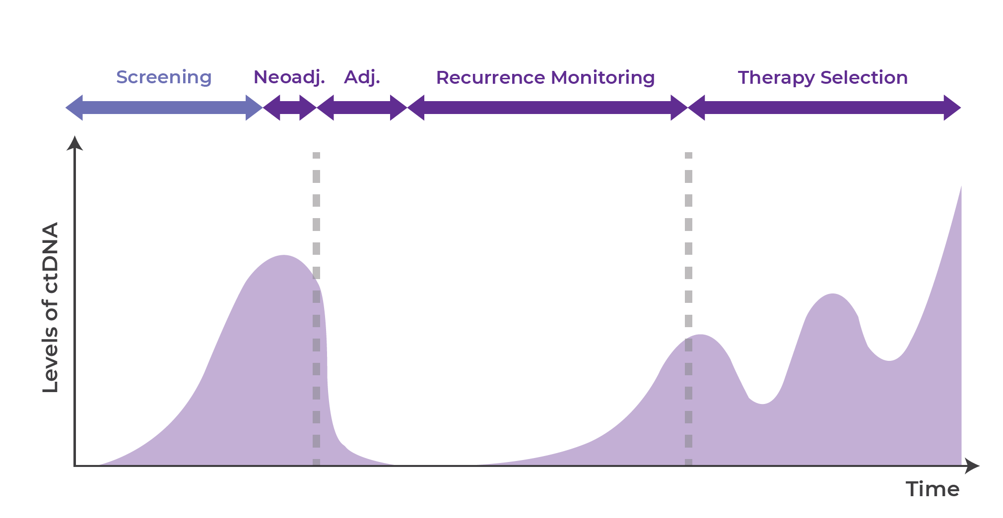
Promise and Application of Circulating Tumor-Derived Material
Serial liquid
biopsy testing
Screening or earlier diagnosis
Molecular profiling or prognostication
Detection of residual disease
Monitoring response
Monitoring evolution
MCED
Relapse
Tumor Burden
Time
Surgery (or other)
Treatment 1
Treatment 2
Treatment selection
MCED: multicancer early detection.
1. Wan JCM, et al. Nat Rev Cancer. 2017;17(4):223-238.

Slide 31





Further Considerations for MCED Development and Acceptance
Forego SOC Screening
Exacerbate disparities
Increase patient anxiety
Over diagnosis and treatment
Procedures due to false +
Cost to society/healthcare system
SOC: standard of care.
Notes:
FAQ #7
How often will MCED testing need to be performed?
At this time, suggested testing intervals for MCED tests have not been established by medical guidelines or test manufacturers. Future decisions about testing intervals may be guided by ongoing studies. Key opinion leaders have highlighted many factors that may be considered, including cancer and precancerous lesion sensitivity/specificity, convenience, integration with current recommended screening, and cost.1
Reference
Friends of Cancer Research Whitepaper. Multi-cancer early detection screening tests: considerations for use of real-world data. Accessed December 22, 2022. https://friendsofcancerresearch.org/wp-content/uploads/MCED_Screening_Tests-Considerations_for_Use_of_Real-World_Data.pdf
FAQ #8
Are there any limitations to MCED technology?
Several potential limitations to MCED testing technology have been identified:
• Some cancers don’t consistently shed detectable biomarker levels,1 Tumor-of-origin predictions and PPV may not be high enough to avoid confirmatory imaging.2
• Precancerous lesions are less likely to shed biomarkers into the blood stream.3
• MCED tests are not currently sensitive enough to confidently rule out cancer, which creates a risk of falsely reassuring someone that they are cancer-free.4
References
1. Cohen JD, Li L, Wang Y, et al. Detection and localization of surgically resectable cancers with a multi-analyte blood test. Science. 2018;359(6378):926-930.
2. Schrag D, McDonnell III CH, Nadauld L, et al. PATHFINDER: A prospective study of a multi-cancer early detection blood test [oral presentation]. Presented at European Society for Medical Oncology Congress 2022. September 9-13, 2022. Paris, France.
3. Diehl F, Li M, Dressman D, et al. Detection and quantification of mutations in the plasma of patients with colorectal tumors. Proc Nat Acad Sci. 2005;102(45):16368-16373.
4. Lennon AM, Buchanan AH, Kinde I, et al. Feasibility of blood testing combined with PET-CT to screen for cancer and guide intervention. Science. 2020;369(6499):eabb9601
FAQ #12
How would false positive test results be handled?
• Patients using current MCED technology should continue with recommended single-organ tests, such as mammograms, CRC screening, cervical screening, or lung and prostate testing if indicated.1
• Concerns that follow-up testing might not find all cancers that an MCED test detected:
o Current MCED studies used comprehensive advanced imaging to follow up positive results, so missed cancers should have been unlikely
▪ In the DETECT-A study, all positive MCED results were evaluated with advanced PET-CT1
▪ In PATHFINDER study, 89% of positive MCED results were evaluated by CT, PET, or MRI2
o Ongoing studies: DETECT-A subjects are being followed for multiple years to continue monitoring for any future cancers—results are pending (DETECT-A extension study)
• Taking another MCED test after a false positive result: This question needs further research to know if this is indicated
References
1. Lennon AM, Buchanan AH, Kinde I, et al. Feasibility of blood testing combined with PET-CT to screen for cancer and guide intervention. Science. 2020;369(6499):eabb9601
2. Schrag D, McDonnell III CH, Nadauld L, et al. PATHFINDER: A prospective study of a multi-cancer early detection blood test [oral presentation]. Presented at European Society for Medical Oncology Congress 2022. September 9-13, 2022. Paris, France.
FAQ #13
Do MCED tests provide information about tissue of origin (TOO)?
• Several biomarker classes--including methylation, proteins, and aneuploidy--can show unique combinations, which may suggest that a certain cancer type is present.1
In current versions of MCED tests, tissue-of-origin predictions may not have much clinical impact
o Lennon et al 2020 gave the example that if 50% of all positives were due to cancer (50% PPV), then the remaining positives would all be false positives with incorrect TOO predictions.2
o In the Shrag ESMO 2022 study, despite an 85% accurate tissue of origin prediction for true positive cases,
▪ The rest of the positives in the study (62%) were false positives which had misleading TOO predictions
▪ Incorrect tissue of origin predictions may delay definitive testing due to the additional rounds of testing—median time to diagnosis was 79 days overall & 162 days for false positives in this study3
▪ Despite TOO predictions, 89% of all positive subjects underwent advanced imaging (CT, PET, or MRI)3
o Even for true positives, advanced imaging is commonly used in diagnosis and tumor staging in true positive patients, even when molecular TOO is available.
References
1. Cohen JD, Li L, Wang Y, et al. Detection and localization of surgically resectable cancers with a multi-analyte blood test. Science. 2018;359(6378):926-930.
2. Lennon AM, Buchanan AH, Kinde I, et al. Feasibility of blood testing combined with PET-CT to screen for cancer and guide intervention. Science. 2020;369(6499):eabb9601
3. Schrag D, McDonnell III CH, Nadauld L, et al. PATHFINDER: A prospective study of a multi-cancer early detection blood test [oral presentation]. Presented at European Society for Medical Oncology Congress 2022. September 9-13, 2022. Paris, France.
FAQ #14
Is this an oncology or primary care tool?
• MCED tests in current development are intended to be used alongside recommended, single-organ screening
o Due to this intent, it may be used as a tool by primary care providers as part of routine care
o But it is possible that oncologists or other specialists may find it useful for their patients, too
• Planned real world studies of the Exact Sciences MCED test will help provide insight into how the medical community will use it

Slide 32
Conclusion
CRC is the 4th most common cancer and the 2nd leading cause of cancer deaths.¹ However, it is preventable and treatable if it is detected early.²
Routine CRC screening is recommended for persons aged 45 and above who are at average risk for CRC.^{3-7*}
Informed decision making and offering patients a choice of screening tests has been shown to improve CRC screening adherence.⁸
Navigation systems are critical for success
New options emerging
*All recommendations are category 2A unless otherwise indicated. The National Comprehensive Cancer Network (NCCN®) makes no representations or warranties of any kind regarding their content, use or application and disclaims any responsibility for their application or use in any way.
AA: advanced adenoma; CRC: colorectal cancer; mt-sDNA: multi-target stool DNA
1. Siegel RL, et al. 2022. CA Cancer J Clin. 2022;72:7-33. 2. Itzkowitz SH, et al. J Natl Cancer Inst. 2009;101(18):1225-1227. 3. Davidson KW, et al. JAMA. 2021;325(19):1965-1977. 4. Wolf AMD, et al. CA Cancer J Clin. 2018;68(4):250-281. 5. Referenced with permission from the NCCN Clinical Practice Guidelines in Oncology (NCCN Guidelines®) for Colorectal Cancer Screening V.2.2021. © National Comprehensive Cancer Network, Inc. 2022. All rights reserved. Accessed February 8, 2022. To view the most recent and complete version of the guideline, go online to NCCN.org. 6. Patel SG, et al. Gastroenterol. 2022;162(1):285-299. 7. Patel SG, et al. Gastroenterol. 2022;162(1):285-299. 8. Inadomi JM et al. Arch Intern Med. 2012;172(7):575-582. 9. Imperiale TF, et al. N Engl J Med. 2014;370(14):1287-1297. 10. Cologuard Physician Brochure. Exact Sciences Corporation. Madison, WI.

Slide 33
Thank You
Catherine Kouchakji PhD, MPH
Medical Science Liaison
608-292-0966
ckouchakji@exactsciences.com
Cologuard is a registered trademark of Exact Sciences Corporation.
©2022 Exact Sciences Corporation. All rights reserved.

